Slide 1

Strings in Python
Jyothi
Venkat

Slide 2
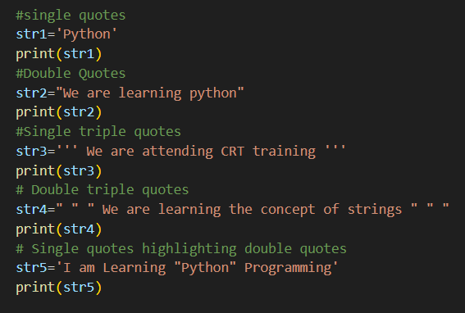
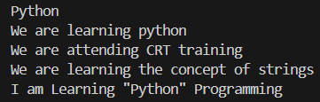
1. Strings are sequences of characters and are immutable.
2. Surrounded by either single quotation marks, or double quotation marks.

Slide 3
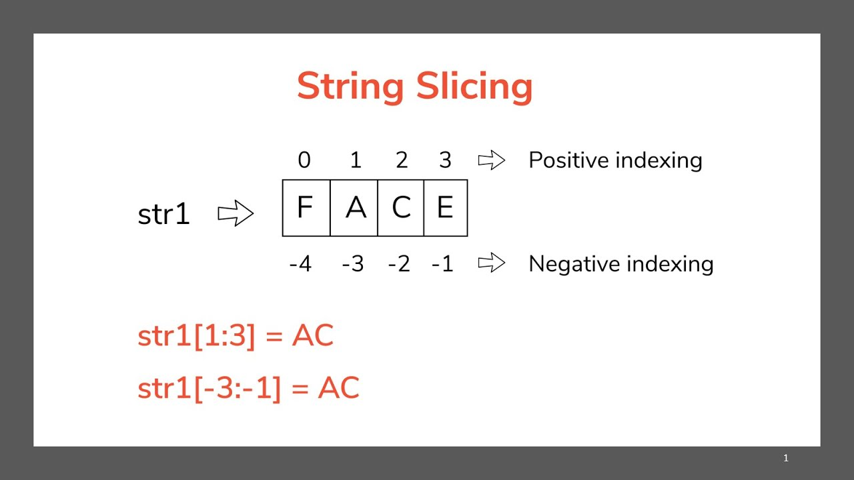
Indexing Strings
We can use positive and negative indices to access characters.
POSITIVE INDEXING
If we perform indexing left to right in the above python string, we have the indices 0 to (N-1).
NEGATIVE INDEXING
If we perform indexing right to left in the above python string, we have the indices -1 to -N.

Slide 4
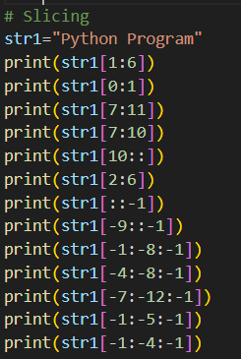
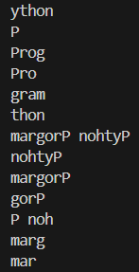
String Slicing
Syntax: string[start:stop:step]
Returns a substring (doesn't modify the original string)

Slide 5
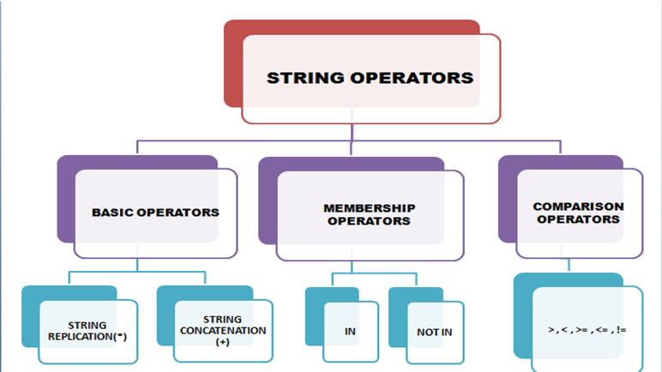

Slide 6
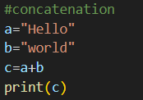


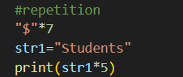
1. Basic Operators
2. Membership Operators
String Concatenation (+)
Joins two strings together.
Example:
in Operator
Returns True if a substring exists in the given string.
not in Operator
Returns True if a substring does not exist in the string.
String Replication (*)
Repeats the string a specified number of times.

Slide 7

3. Comparison Operators
These compare two strings based on lexicographical (dictionary) order:
== → Equal
!= → Not equal
> → Greater than
< → Less than
>= → Greater than or equal to
<= → Less than or equal to

Slide 8
Python String Methods
1. capitalize() - Converts the first character of the string to uppercase and the rest to lowercase.
2. isalnum() - Checks if all characters are alphanumeric.
3. isalpha() - Checks if all characters are alphabetic.
4. isascii() - Checks if all characters are ASCII.
5. isdecimal() - Checks if all characters are decimal digits.
6. isdigit() - Checks if all characters are digits.
7. islower() - Checks if all characters are lowercase.
8. isnumeric() - Checks if all characters are numeric.
9.istitle() - Checks if the string is title-cased.
10. isupper() - Checks if all characters are uppercase.
11. join(iterable) - Joins elements of an iterable with the string as a separator.
12. lower() - Converts all characters to lowercase.
13. replace(old, new[, count]) - Replaces occurrences of a substring
14. split([sep[, maxsplit]]) - Splits the string into a list.
15. startswith(prefix[, start[, end]]) - Checks if the string starts with the specified prefix.
16. strip([chars]) - Removes leading and trailing characters (default is whitespace).
17. swapcase() - Swaps the case of all characters.
18. title() - Converts the string to title case.
19. upper() - Converts all characters to uppercase.

Slide 9
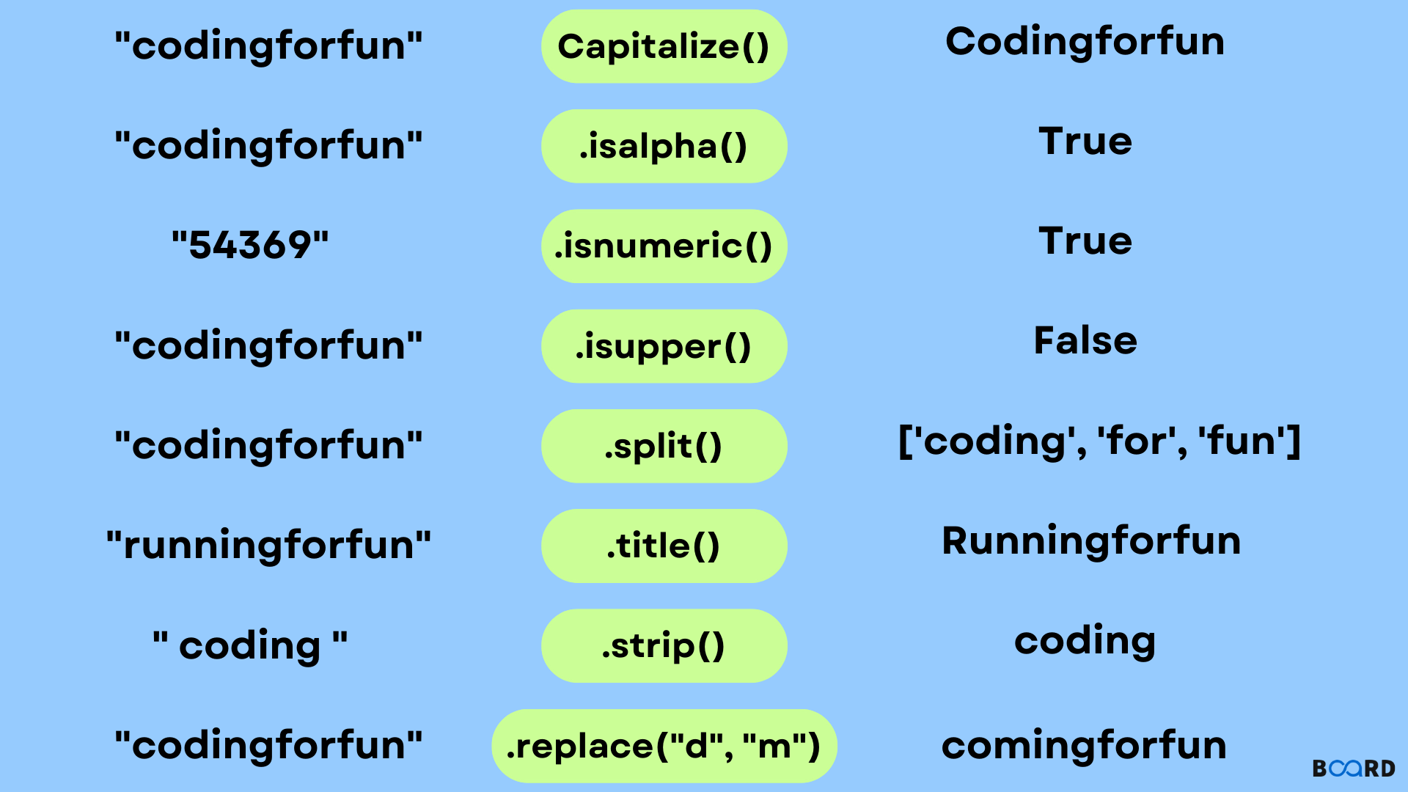

Slide 10
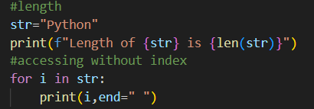


In Python, a for loop can be used to access each character in a string one by one.

Slide 11
THANK YOU

